Slide 1

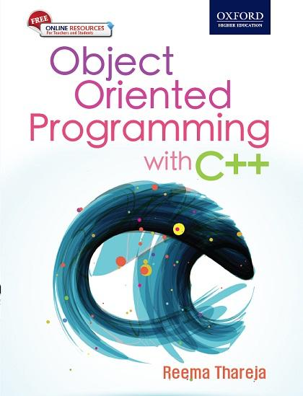
Object Oriented Programming
with C++
Reema Thareja

Slide 2
Chapter Four
Functions

Slide 3
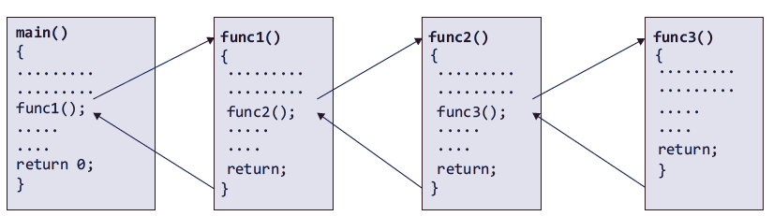
INTRODUCTION
C++ enables programmers to break up a program into segments commonly known as functions.
Each function can be written more or less independently of the others. Every function in the program is supposed to perform a well-defined task.
It is not necessary that the main() can call only one function. It can call as many functions as it wants and as many times as it wants.
Any function can call any other function
© Oxford University Press 2015. All rights reserved.

Slide 4
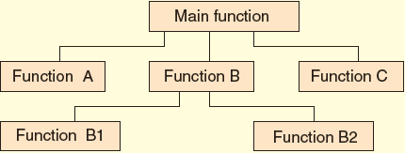
NEED FOR FUNCTIONS
Dividing the program into separate well-defined functions facilitates each function to be written and tested separately.
Understanding, coding, and testing multiple separate functions are far easier than doing the same for one huge function.
All libraries in C++ contain a set of functions that programmers are free to use in their programs.These functions have been prewritten and pretested.
When a big program is broken into comparatively smaller functions, different programmers working on that project can divide the workload by writing different functions.
Like C++ libraries, programmers can also make their functions and use them from different points in the main program or any other program that needs its functionalities.
© Oxford University Press 2015. All rights reserved.

Slide 5
USING FUNCTIONS
A function, f , that uses another function g, is known as the calling function and g is known as the called function.
The inputs that the function takes are known as arguments or parameters.
When a called function returns some result back to the calling function, it is said to return that result.
The calling function may or may not pass parameters to the called function.
If the called function accepts the arguments, the calling function will pass parameters, otherwise, it will not do so.
Function declaration is a declaration statement that identifies a function with its name, a list of arguments that it accepts, and the type of data it returns.
© Oxford University Press 2015. All rights reserved.

Slide 6
USING FUNCTIONS
Function definition consists of a function header that identifies the function, followed by the body of the function containing the executable code for that function.
© Oxford University Press 2015. All rights reserved.

Slide 7
FUNCTION DECLARATION OR FUNCTION PROTOTYPE
function_name is a valid name for the function.
return_data_type specifies the data type of the value that will be returned to the calling function as a result of the processing performed by the called function.
data_type variable1, data_type variable2, … is a list of variables of specified data types.
After the declaration of every function, there is a semicolon.
The name of the function is global.
© Oxford University Press 2015. All rights reserved.

Slide 8
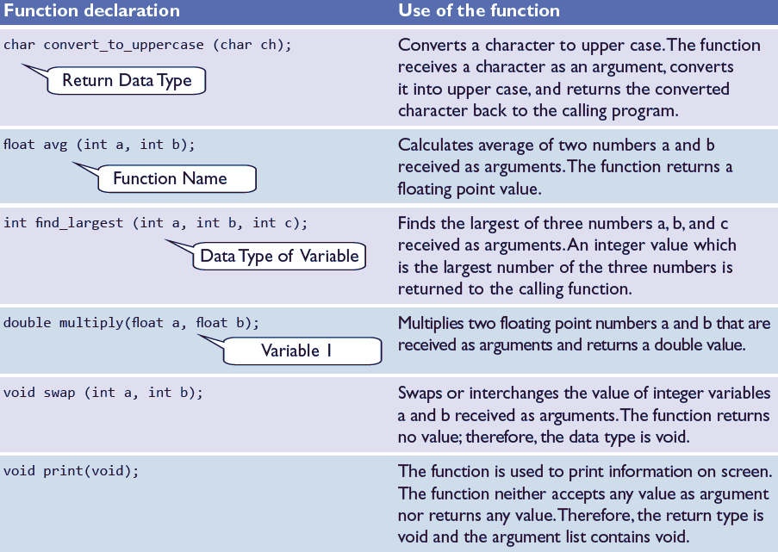
© Oxford University Press 2015. All rights reserved.

Slide 9
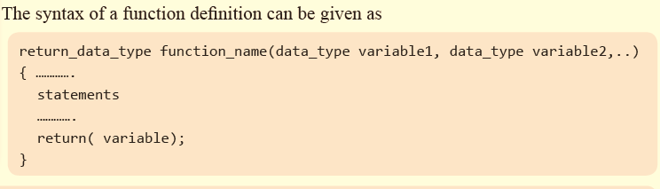
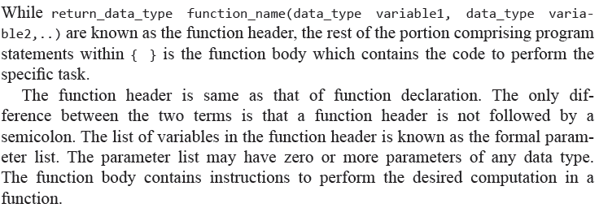
FUNCTION DEFINITION
© Oxford University Press 2015. All rights reserved.

Slide 10

FUNCTION CALL
Function name and the number and type of arguments in the function call must be the same as that given in the function declaration and function header of the function definition.
If, by mistake, the parameters passed to a function are more than specified to accept, then the extra arguments will be discarded.
If, by mistake, the parameters passed to a function are less than specified to accept, then the unmatched argument will be initialized to some garbage value (i.e. arbitrary meaningless value).
Names, and not the types, of variables in function declaration, function call, and header of function definition may vary.
Arguments may be passed in the form of expressions to the called function.
© Oxford University Press 2015. All rights reserved.

Slide 11
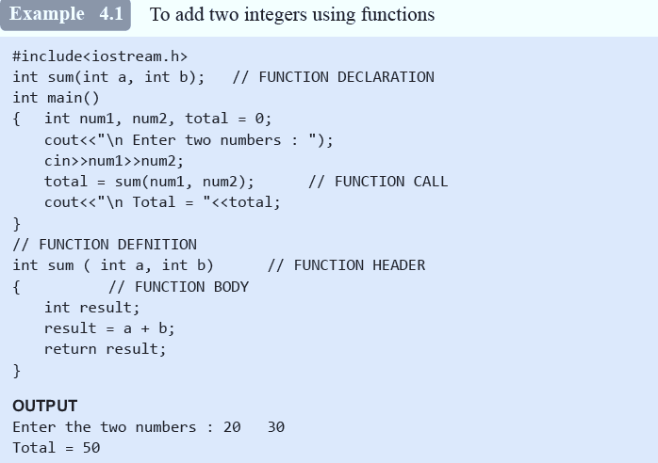
© Oxford University Press 2015. All rights reserved.

Slide 12

RETURN STATEMENT
The return statement is used to terminate the execution of a function and return control to the calling function.
When the return statement is encountered, the program execution resumes in the calling function at the point immediately following the function call.
A return statement may or may not return a value to the calling function.
© Oxford University Press 2015. All rights reserved.

Slide 13
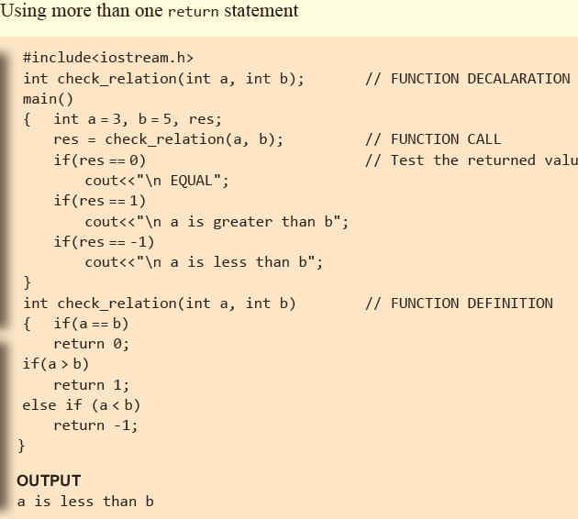
© Oxford University Press 2015. All rights reserved.

Slide 14
PASSING PARAMETERS TO THE FUNCTION
When a function is called, the calling function may have to pass some values to the called function.
There are two ways in which arguments or parameters can be passed to the called function.
They include the following:
• Call-by-value, in which values of the variables are passed by the calling function to the called function. The programs that we have written so far call the function using call-by-value method of passing parameters.
• Call-by-address, in which the address of the variables is passed by the calling function to the called function.
• Call-by-reference , in which a reference of the variable is passed by the calling function to the called function.
© Oxford University Press 2015. All rights reserved.

Slide 15
Call-by-Value
In this method, the called function creates new variables to store the value of the arguments passed to it.
Therefore, the called function uses a copy of the actual arguments to perform its intended task.
If the called function is supposed to modify the value of the parameters passed to it, then the change will be reflected only in the called function.
In the calling function, no change will be made to the value of the variables.
© Oxford University Press 2015. All rights reserved.

Slide 16
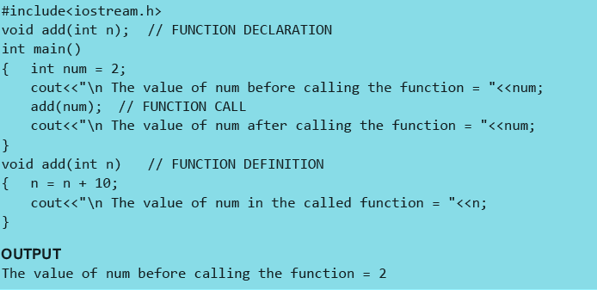
1
© Oxford University Press 2015. All rights reserved.

Slide 17
Call-by-Address
The call-by-pointer or call-by-address method of passing arguments to a function copies the address of an argument into the formal parameter.
The function then uses the address to access the actual argument. This means that any changes made to the value stored at a particular address will be reflected in the calling function also.
The called function uses pointers to access the data. In other words, the dereferencing operator is used to access the variables in the called function.
© Oxford University Press 2015. All rights reserved.

Slide 18
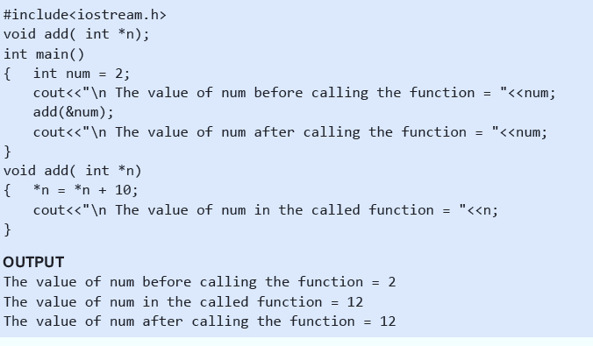
© Oxford University Press 2015. All rights reserved.

Slide 19
Call-by-Reference
When the calling function passes arguments to the called function using call-by-value method, the only way to return the modified value of the argument to the caller is by using the return statement explicitly.
A better option when a function can modify the value of the argument is to pass arguments using call-by-reference technique.
In call-by-reference, we declare the function parameters as references rather than normal variables.
When this is done, any changes made by the function to the arguments it received are visible by the calling program.
© Oxford University Press 2015. All rights reserved.

Slide 20
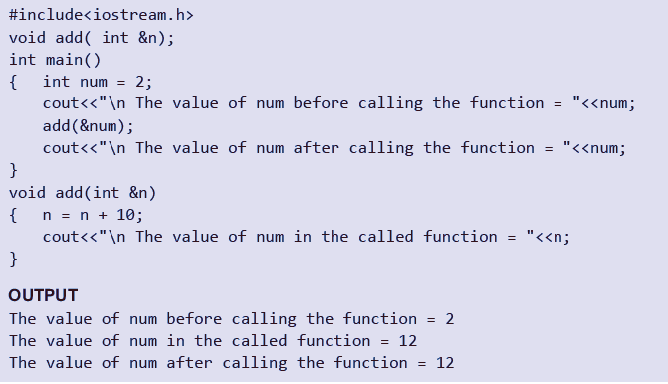
© Oxford University Press 2015. All rights reserved.

Slide 21
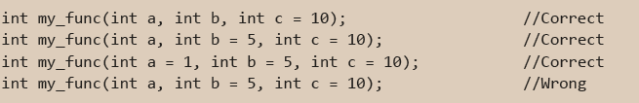
DEFAULT ARGUMENTS
When a function is specified with default arguments, the function can be called with missing arguments.
When a function is called with a missing argument, the function assigns a default value to the parameter.
This default value is specified by the programmer in the function declaration statement.
While specifying the default values during function declaration, the programmer must keep the following in mind.
Only trailing arguments can have default values; therefore, specify them from right to left.
No argument specified in the middle can have default values.
© Oxford University Press 2015. All rights reserved.

Slide 22
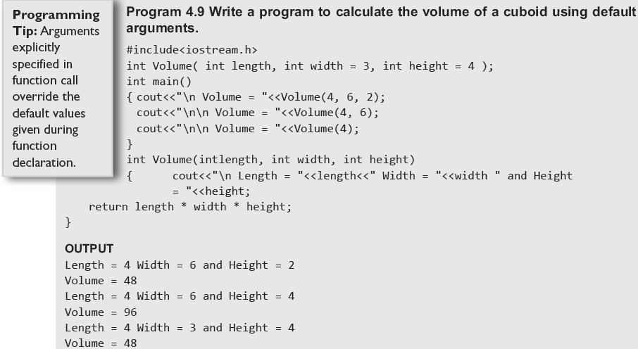
© Oxford University Press 2015. All rights reserved.

Slide 23
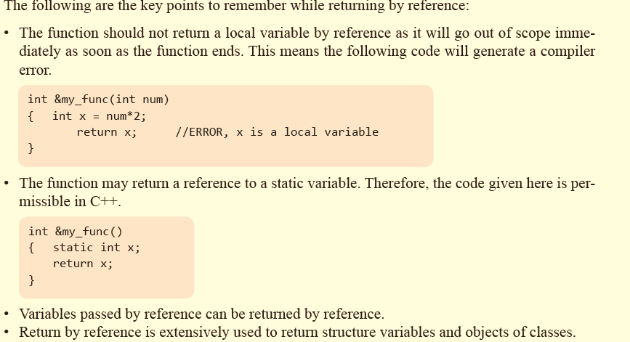
RETURN BY REFERENCE
This allows a function to be used on the left side of an assignment statement.
© Oxford University Press 2015. All rights reserved.

Slide 24
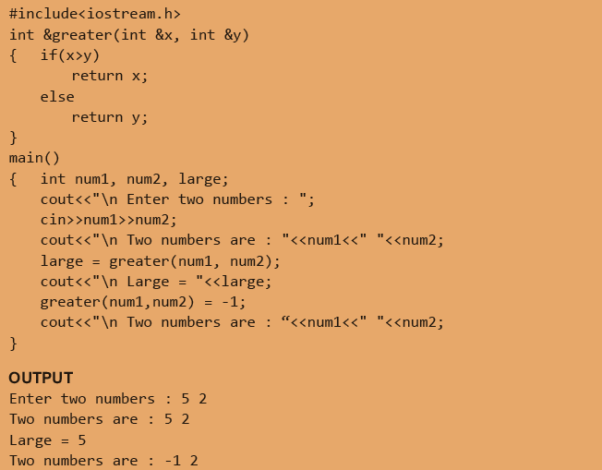
© Oxford University Press 2015. All rights reserved.

Slide 25
PASSING CONSTANTS AS ARGUMENTS
When parameters are passed by reference parameter, the called function may intentionally or inadvertently modify the actual parameters.
However, at times, the programmer may strictly want the actual parameters not to be modified by the called function.
In such cases, a constant parameter must be passed.
Therefore, using the const keyword allows programmers to achieve performance benefits while ensuring that the actual parameter is not modified.
© Oxford University Press 2015. All rights reserved.

Slide 26
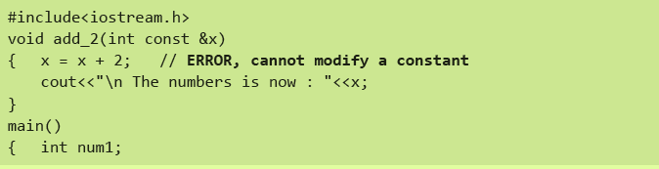
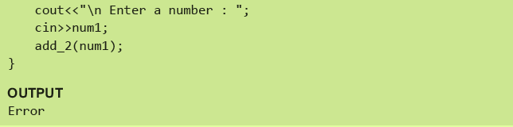
© Oxford University Press 2015. All rights reserved.

Slide 27
VARIABLES SCOPE
In C++, all constants and variables have a defined scope.
By scope, we mean the accessibility and visibility of variables at different points in the program.
A variable or a constant in C++ has four types of scope—block, function, file, and program scope.
Block Scope
A statement block is a group of statements enclosed within an opening and closing curly brackets ({ }).
If a variable is declared within a statement block, as soon as the control exits that block, the variable will cease to exist.
Such a variable also known as a local variable is said to have a block scope.
© Oxford University Press 2015. All rights reserved.

Slide 28
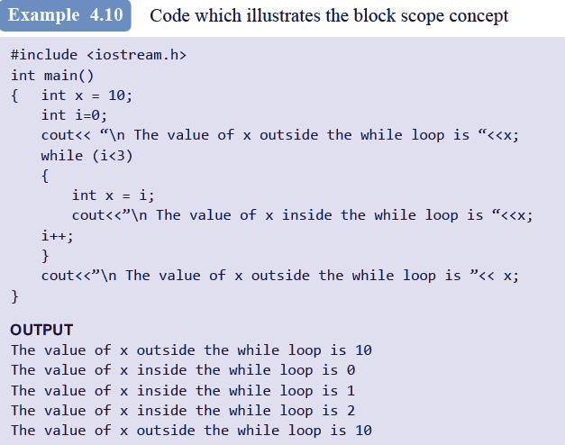
© Oxford University Press 2015. All rights reserved.

Slide 29
VARIABLES SCOPE
Function Scope
Function scope indicates that a variable is active and visible from the beginning to the end of a function.
In C++, only the goto label has function scope.
Scope of the Program
If you want the functions to be able to access some variables which are not passed to them as arguments, declare those variables outside any function blocks. Such variables are commonly known as global variables.
Global variables are those variables that can be accessed from any point in the program.
© Oxford University Press 2015. All rights reserved.

Slide 30
VARIABLES SCOPE
File Scope
When a global variable is accessible until the end of the file, the variable is said to have file scope.
To allow a variable to have file scope, declare that variable with the static keyword before specifying its data type as follows:
A global static variable can be used anywhere from the file in which it is declared but it is not accessible by any other files. Such variables are useful when the programmer writes his own header files.
© Oxford University Press 2015. All rights reserved.

Slide 31
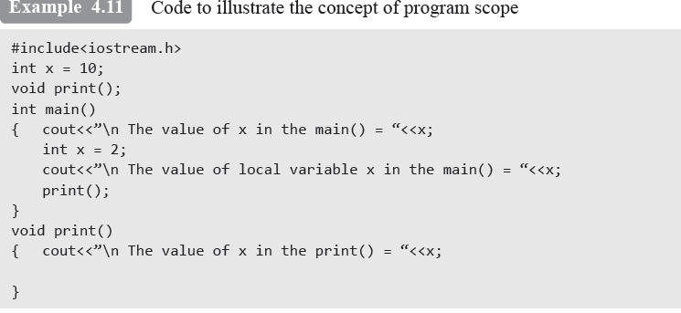
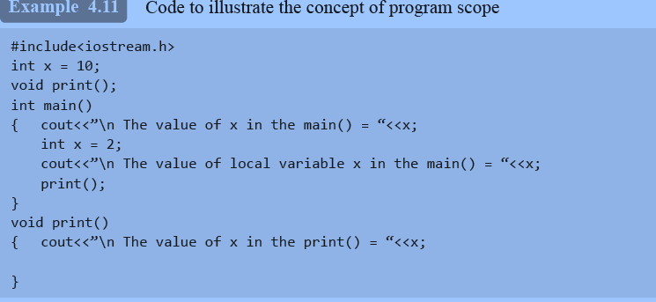
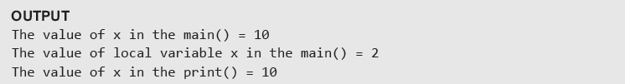
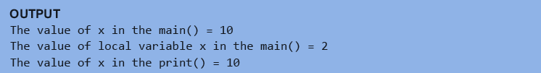
© Oxford University Press 2015. All rights reserved.

Slide 32
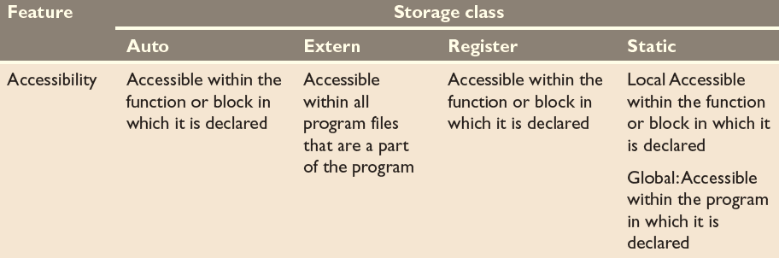
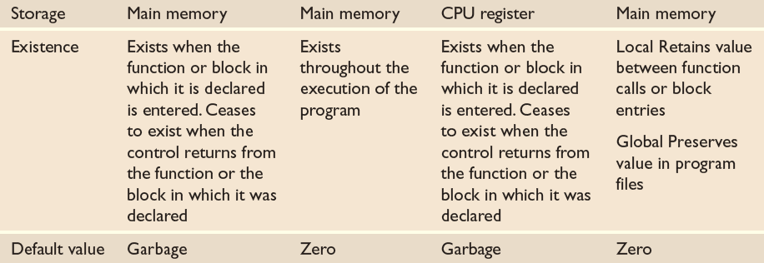
STORAGE CLASSES
The storage class of a variable defines the scope or visibility and life time of variables and/or functions declared within a C++ program.
© Oxford University Press 2015. All rights reserved.

Slide 33
INLINE FUNCTIONS
The major difference between an ordinary function and an inline function is that when an inline function is called, the compiler places a copy of its code at each point of call.
As in case of an ordinary function, the compiler does not have to jump to the called function.
This saves the function call overhead and results in faster execution of the code.
We can make a function inline by taking caring of two aspects as follows:
• First, write the keyword inline before the function name.
• Second, define that function before any calls are made to it.
© Oxford University Press 2015. All rights reserved.

Slide 34
INLINE FUNCTIONS
However, the programmer must not forget that keyword inline just makes a request to the compiler to make the function inline (and place its code at each point of call).
The compiler may ignore the request if the function has too many lines.
© Oxford University Press 2015. All rights reserved.

Slide 35
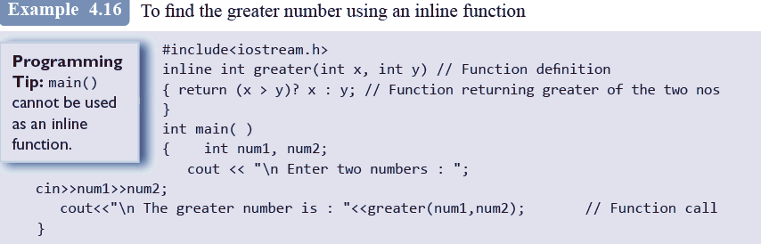

© Oxford University Press 2015. All rights reserved.

Slide 36
ADVANTAGES
An inline function generates faster code as it saves the time required to execute function calls.
Small inline functions (three lines or less) create less code than the equivalent function call as the compiler does not have to generate code to handle function arguments and a return value.
Inline functions are subject to code optimizations that are usually not available to normal functions as the compiler does not perform inter-procedural optimizations.
Inline function avoids function call overhead. As a result, we need to save variables and other program parameters on the system stack.
© Oxford University Press 2015. All rights reserved.

Slide 37
ADVANTAGES
Since there are no function calls, the overhead of returning from a function is also avoided.
It allows the compiler to apply intra-procedural optimization
© Oxford University Press 2015. All rights reserved.

Slide 38
DISADVANTAGES
Size of the program increases.
Large programs may take longer time to be executed.
At times, the program may not fit in the cache memory.
There may be a problem in making efficient use of CPU registers if the inline function has many register variables.
If the code of the inline function is modified, the entire program needs to be re-compiled.
Inline functions should not be used for designing embedded systems due to memory size constraints.
© Oxford University Press 2015. All rights reserved.

Slide 39
COMPARISON OF INLINE FUNCTIONS WITH MACROS
Macro invocations skip the job of type checking; this is a must-to-do work in function calls.
Macros cannot return a value while a function can return a value.
Macros use mere textual substitution which can give unintended results due to inaccurate reevaluation of arguments and order of operations.
Debugging of compiler errors in case of macros is more difficult than debugging functions.
All constructs cannot be expressed using macros; however, with functions, they can be expressed with ease.
Macros have a slightly difficult syntax while the syntax of writing function is similar to that of a normal function.
© Oxford University Press 2015. All rights reserved.

Slide 40
FUNCTION OVERLOADING
Function overloading, also known as method overloading, is a feature in C++ that allows creation of several methods with the same name but with different parameters.
For example, print(), print(int), and print("Hello") are overloaded methods.
While calling print() , no arguments are passed to the function; however, when calling print(int) and print("Hello") , an integer and a string arguments are passed to the called function.
Function overloading is a type of polymorphism.
© Oxford University Press 2015. All rights reserved.

Slide 41
FUNCTION OVERLOADING
Basically, there are two types of polymorphism:
Compile time (or static) polymorphism and run-time (or dynamic) polymorphism.
Function overloading falls in the category of static polymorphism which calls a function using the best match technique or overload resolution.
© Oxford University Press 2015. All rights reserved.

Slide 42

MATCHING FUNCTION CALLS WITH OVERLOADED FUNCTIONS
When an overloaded function is called, one of the following cases occurs:
Case 1: A direct match is found, and there is no confusion in calling the appropriate overloaded function.
Case 2: If a match is not found, a linker error will be generated. However, if a direct match is not found, then, at first, the compiler will try to find a match through the type conversion or type casting.
Case 3: If an ambiguous match is found, that is, when the arguments match more than one overloaded function, a compiler error will be generated. This usually happens because all standard conversions are treated equal.
© Oxford University Press 2015. All rights reserved.

Slide 43
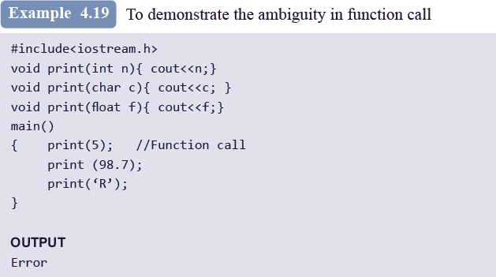
© Oxford University Press 2015. All rights reserved.

Slide 44
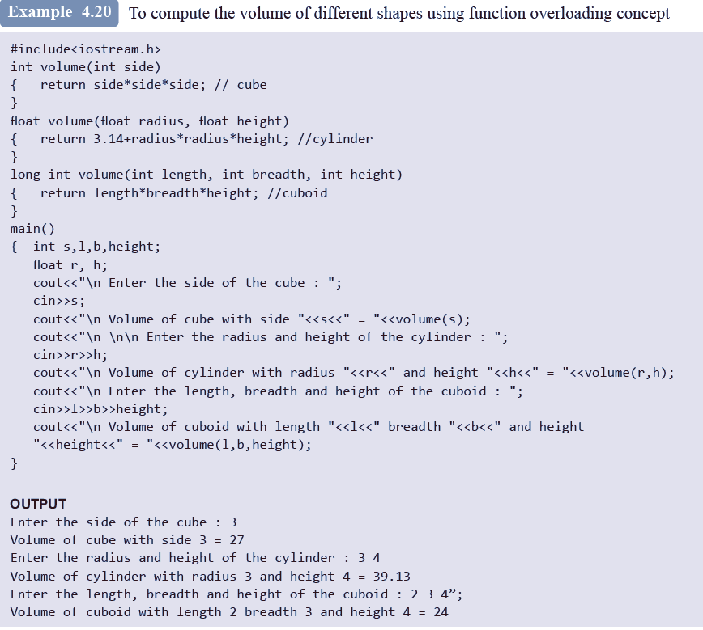
© Oxford University Press 2015. All rights reserved.

Slide 45
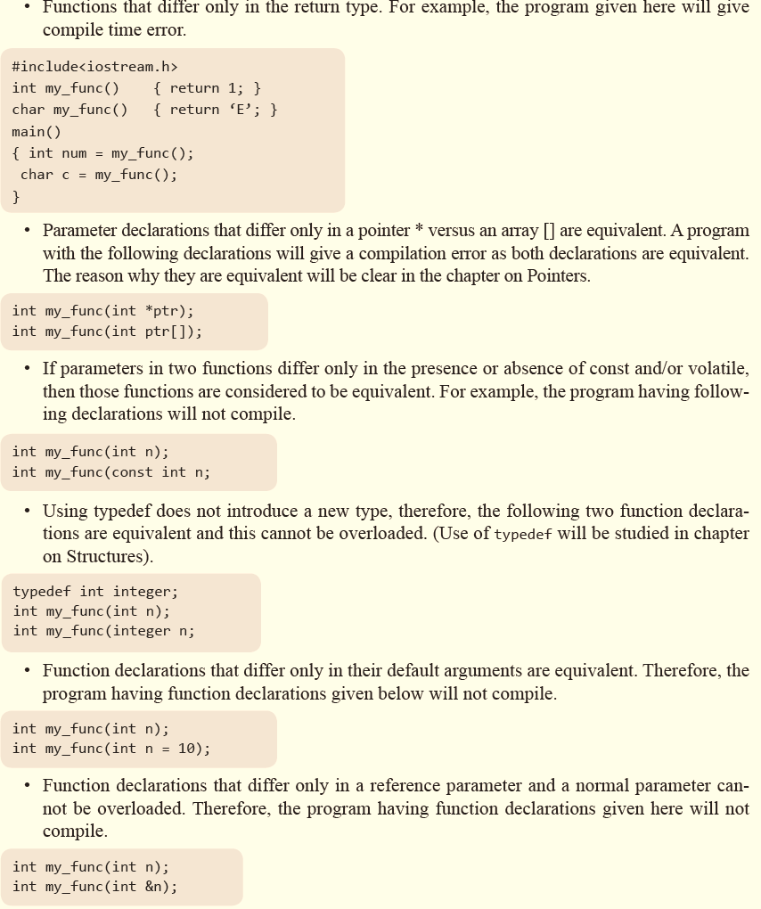
Functions that Cannot be Overloaded
© Oxford University Press 2015. All rights reserved.

Slide 46
RECURSIVE FUNCTIONS
A recursive function is defined as a function that calls itself to solve a smaller version of its task until a final call is made which does not require a call to itself.
Every recursive solution has two major cases which are given as follows:
Base case, in which the problem is simple enough to be solved directly without making any further calls to the same function.
Recursive case, in which first the problem at hand is divided into simpler sub parts.
Second, the function calls itself but with sub parts of the problem obtained in the first step.
Third, the result is obtained by combining the solutions of simpler sub-parts.
© Oxford University Press 2015. All rights reserved.

Slide 47
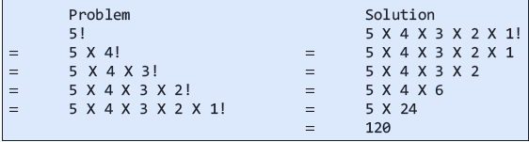
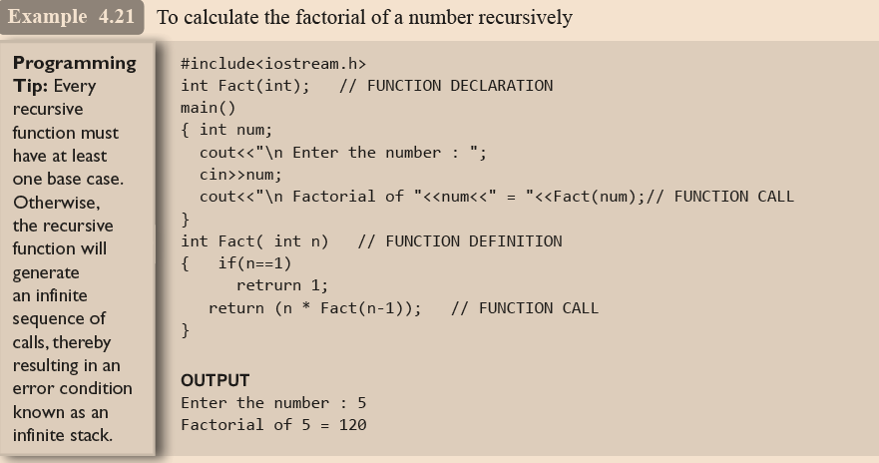
© Oxford University Press 2015. All rights reserved.

Slide 48
ADVANTAGES
Recursive solutions often tend to be shorter and simpler than non-recursive ones.
Code is clearer and easier to use.
Recursion represents like the original formula to solve a problem.
Follows a divide and conquer technique to solve problems.
In some (limited) instances, recursion may be more efficient.
© Oxford University Press 2015. All rights reserved.

Slide 49
DISADVANTAGES
For some programmers and readers, recursion is a difficult concept.
Recursion is implemented using system stack.
If the stack space on the system is limited, recursion to a deeper level will be difficult to implement.
Aborting a recursive process in midstream is slow and sometimes nasty.
Using a recursive function takes more memory and time to execute as compared to its non-recursive counter part.
It is difficult to find bugs, particularly, when using global variables
© Oxford University Press 2015. All rights reserved.

Slide 50
FUNCTIONS WITH VARIABLE NUMBER OF ARGUMENTS
In case we need a function that should accept a variable number of arguments, we have to design a function that accepts the data-type and/or number of arguments at the run-time while execution and not during compilation.
Let us take a sample program that accepts any number of values and then return the average.
To write such a program, we must include the cstdarg header file to use the following macros:
va_list that stores the list of arguments.
va_start to initialize the list.
It is a macro from which we can begin reading arguments from it. It accepts two arguments— va_list and a last named
© Oxford University Press 2015. All rights reserved.

Slide 51
FUNCTIONS WITH VARIABLE NUMBER OF ARGUMENTS
argument. After the last named argument, the number of arguments read is stored.
va_arg returns the next argument in the list. It helps in accessing the individual arguments
in the list. For this, you must just need to specify the type of argument to retrieve.
va_end is used to clean up the variable argument list once we are done with it.
A function that is supposed to accept variable number of arguments must be declared in a special way.
Instead of writing the last argument, you must put an ellipsis (like ‘…’). Therefore, int my_func( int x, … ); means that my_func accepts any number of arguments.
© Oxford University Press 2015. All rights reserved.

Slide 52
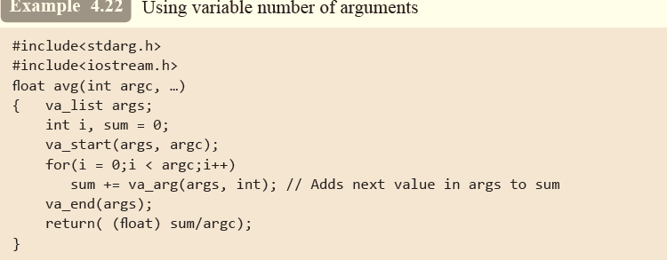
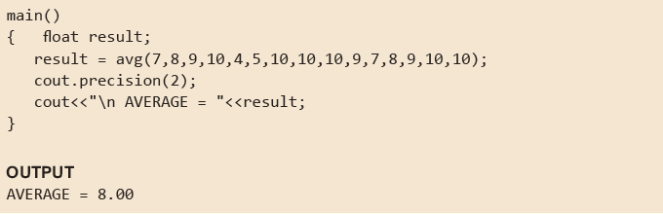
© Oxford University Press 2015. All rights reserved.

